Slide 1
Thematic Apperception Test
TAT Set-7

Slide 2
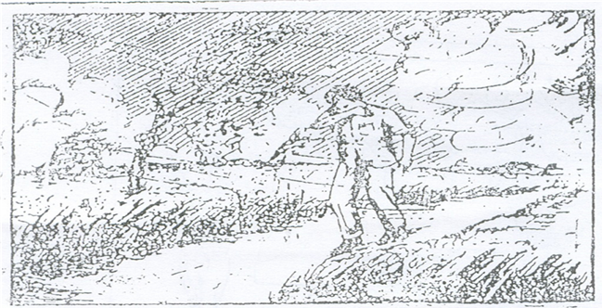

Slide 3
Start writing

Slide 4
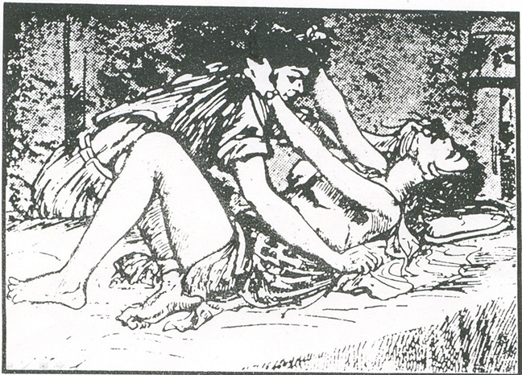

Slide 5
Start writing

Slide 6
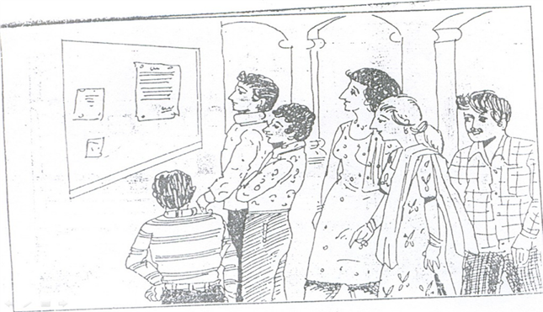

Slide 7
Start writing

Slide 8
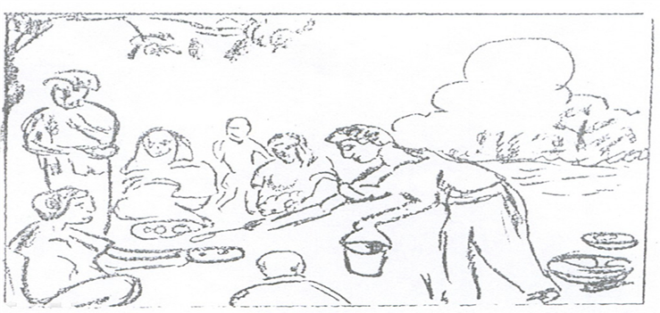

Slide 9
Start writing

Slide 11
Start writing

Slide 13
Start writing

Slide 14
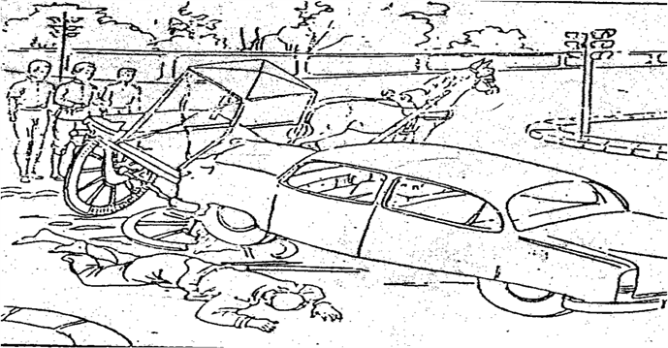

Slide 15
Start writing

Slide 17
Start writing

Slide 18
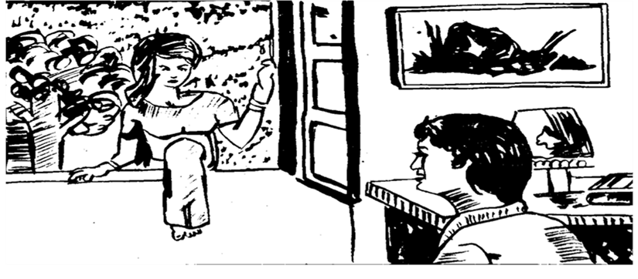

Slide 19
Start writing

Slide 21
Start writing

Slide 22
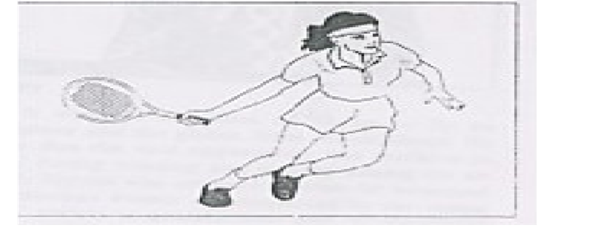

Slide 23
Start writing

Slide 24
Blank slide

Slide 25
The End

